Slide 1
The Fundamental of Mobile Robot
Machine Perception and Interaction Group (MPIG)
assignments.shmtu@gmail.com

Slide 2
Send an email with specified subject ‘Robot stuff’ to
assignments.shmtu@gmail.com
An automatic reply will come.
All you need would be included!

Slide 3

assignments.shmtu@gmail.com

Slide 4


All the codes accompanying this course are open-sourced at Github.
The project homepage:
https://github.com/sunzuolei/robotcourse
The git repository:
https://github.com/sunzuolei/robotcourse.git
Learn more about git:
http://en.wikipedia.org/wiki/Git_(software)
The best GUI-based git client on Windows:
https://code.google.com/p/tortoisegit/

Slide 5
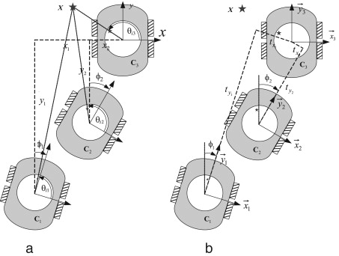
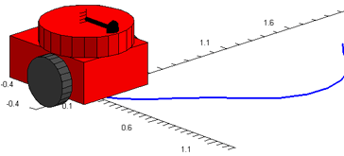
Geometry in Robotics

Slide 6
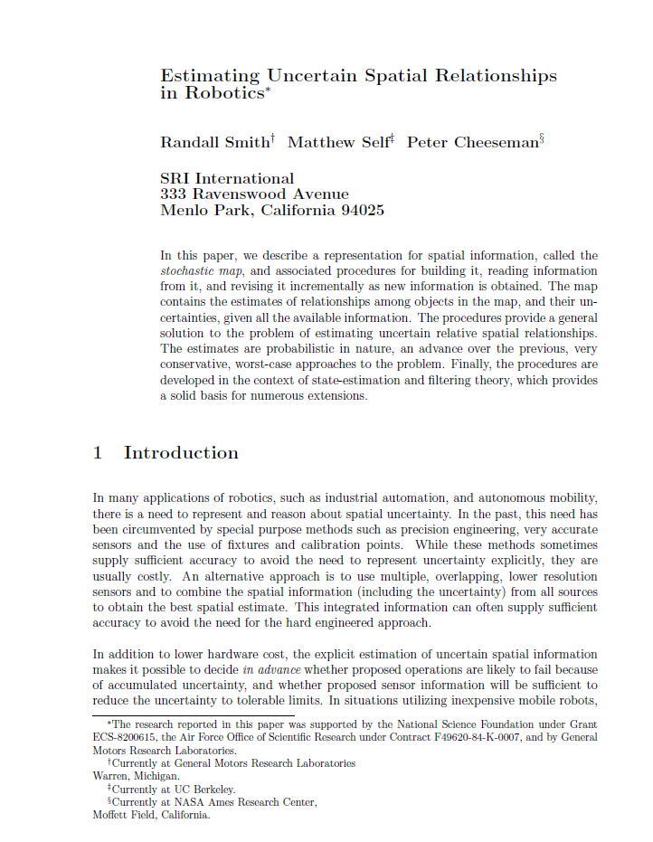
@article{
author = {Smith, R. and Self, M. and Cheeseman, P.},
title = {Estimating uncertain spatial relationships in robotics},
journal = {Autonomous Robot Vehicles},
pages = {167-193},
year = {1990}
}

Slide 7
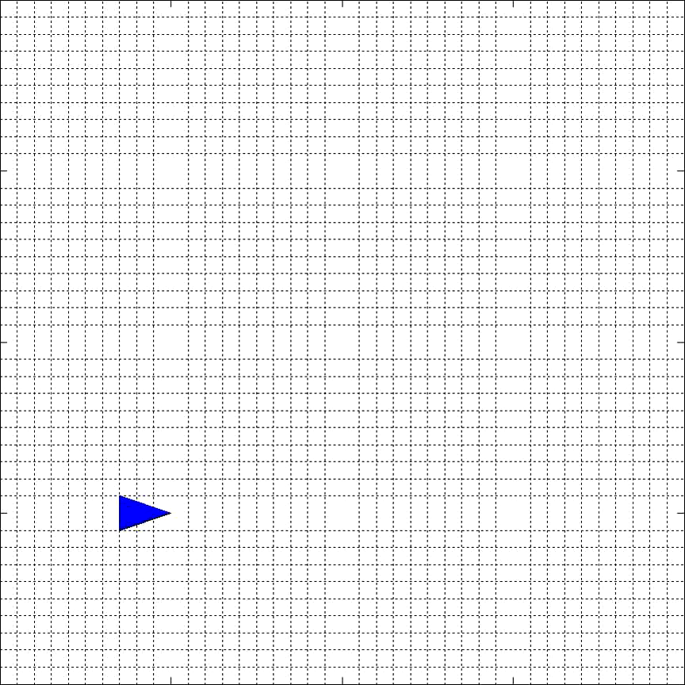

Slide 8
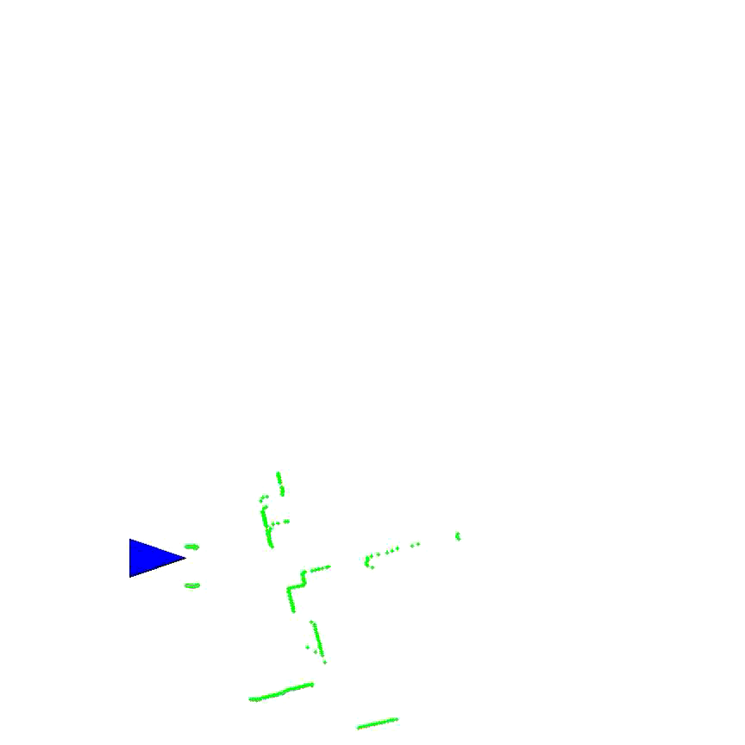

Slide 9
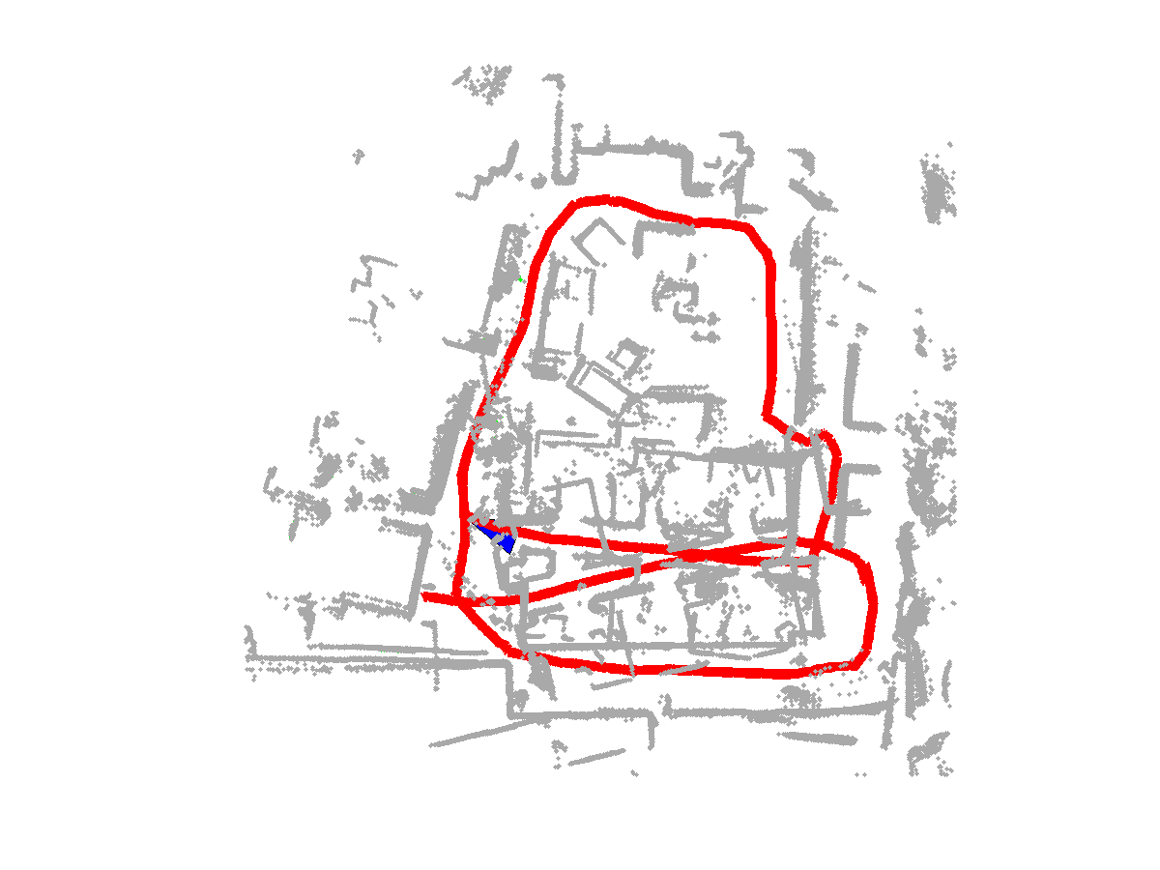
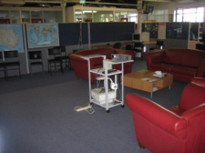
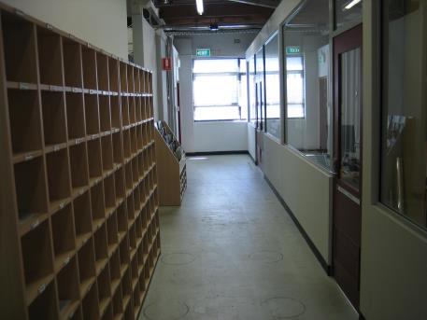
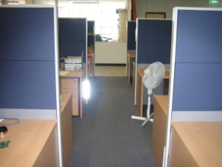
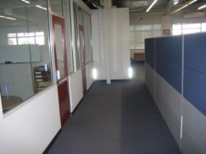

Slide 10

What are the essential issues behind the demos?

Slide 11
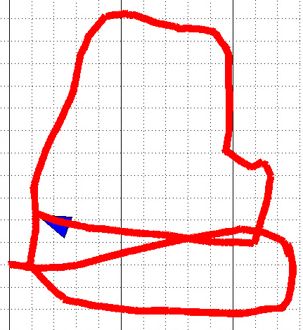
Coordinate frames
Spatial relationships
Transformation

Slide 12

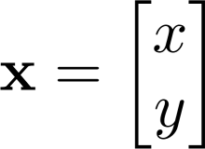

Suppose the robot starts from [A, B], then it moves C along x and D along y, where is the robot now?

Slide 13
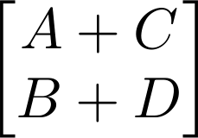
We can locate the robot at
Let us calculate it more elegantly.

Slide 14
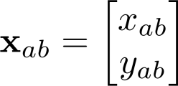
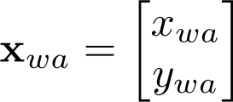


Slide 15


Slide 16
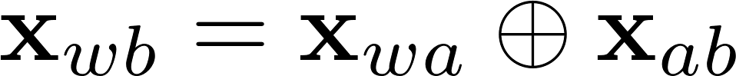


head-to-tail
Compounding

Slide 17



Compounding

Slide 18

Compounding

Slide 19
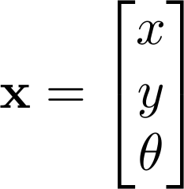
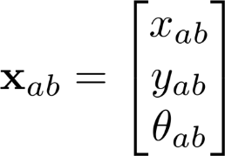
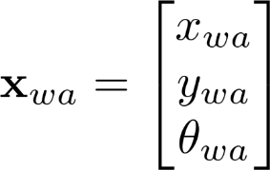

Slide 20
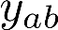

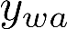
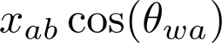

Slide 22
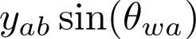

Slide 23
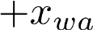

Slide 24


Slide 25
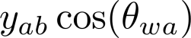

Slide 29
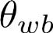
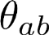
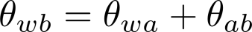

Slide 30
head-to-tail
Compounding

Slide 31
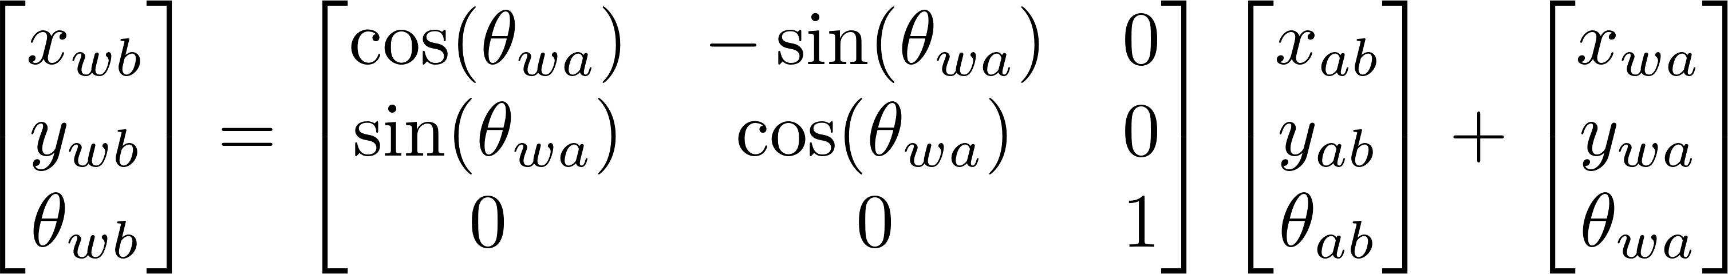
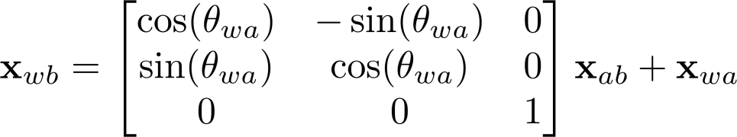

Slide 32
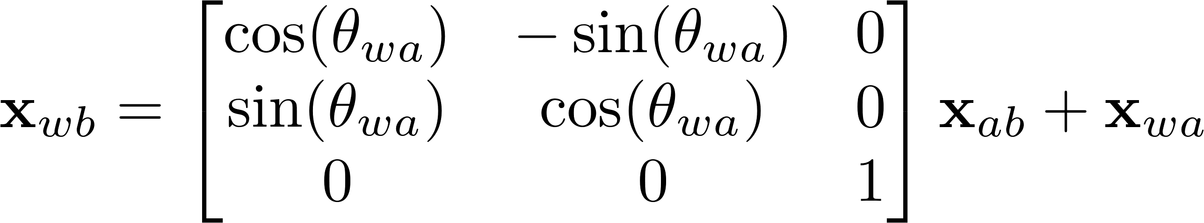
Transformation matrix
Translation
Rotation
http://en.wikipedia.org/wiki/Transformation_matrix

Slide 33
Robot-centered frame
Sensor-centered frame
Robot-centered frame
Sensor-centered frame
World frame

Slide 34
The coordinate of pose a is (5m, 3m, 50degree) ;
The pose b locates at
(4m, 2m, 20degree)
with respect to the robot-centered frame of pose a.
What is the coord. of pose b w.r.t world frame?

Slide 35
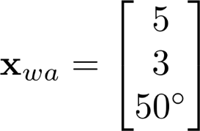

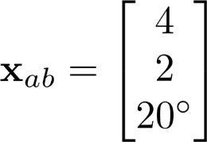
The coordinate of pose a is (5m, 3m, 50degree) ;
The pose b locates at
(4m, 2m, 20degree)
with respect to the robot-centered frame of pose a.
What is the coord. of pose b w.r.t world frame?

Slide 36
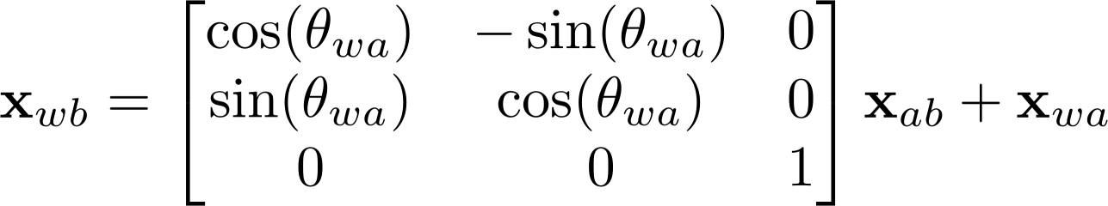
Let’s implement this!
head-to-tail
Compounding

Slide 37
P22
Xwa = [5; 3; degtorad(50)];
Xab = [4; 2; degtorad(20)];
Xwb = compound(Xwa, Xab);
fprintf('Xwb is (%.2fm, %.2fm, %.2fdegree)\n',...
Xwb(1), Xwb(2), radtodeg(Xwb(3)));

Slide 38
P22
function Xwb = compound(Xwa, Xab)
rot = [cos(Xwa(3)) -sin(Xwa(3));
sin(Xwa(3)) cos(Xwa(3))];
Xwb(1:2,:) = rot * Xab(1:2,:) +
repmat(Xwa(1:2), 1, size(Xab,2));
%% if Xwb is a pose and not a point
if size(Xab,1) == 3
Xwb(3,:) = piTopi(Xwa(3,:) + Xab(3));
end
end
Xab can be of size 3*n or 2*n

Slide 39
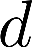
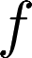
The coordinate of pose a is (5m, 3m, 50degree) ;
Two features are sensed. Their coordinates in robot-centered frame are
(3m, 2.5m), (5m, 2m).
What are the coords. of feature f and d w.r.t world frame?

Slide 40
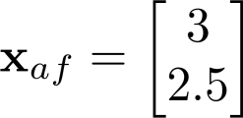
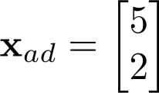
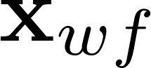

The coordinate of pose a is (5m, 3m, 50degree) ;
Two features are sensed. Their coordinates in robot-centered frame are
(3m, 2.5m), (5m, 2m).
What are the coords. of feature f and d w.r.t world frame?

Slide 41

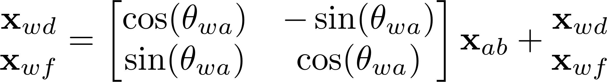
Let’s implement this!
head-to-tail
Compounding

Slide 42
P23
Xwa = [5; 3; degtorad(50)];
Xad = [5; 2];
Xaf = [3; 2.5];
Xadf = [Xad, Xaf];
Xwd = compound(Xwa, Xad);
Xwf = compound(Xwa, Xaf);
Xwdf = compound(Xwa, Xadf);
%%
disp('Xwd = ');
disp(Xwd);
disp('Xwf = ');
disp(Xwf);
disp('Xwdf = ');
disp(Xwdf);

Slide 43
The coordinate of pose a is (5m, 3m, 50degree) ;
The pose b locates at
(4m, 2m, 20degree)
with respect to the robot-centered frame of pose a.
Let’s implement this!
How can we visualize the robot body shape?

Slide 44
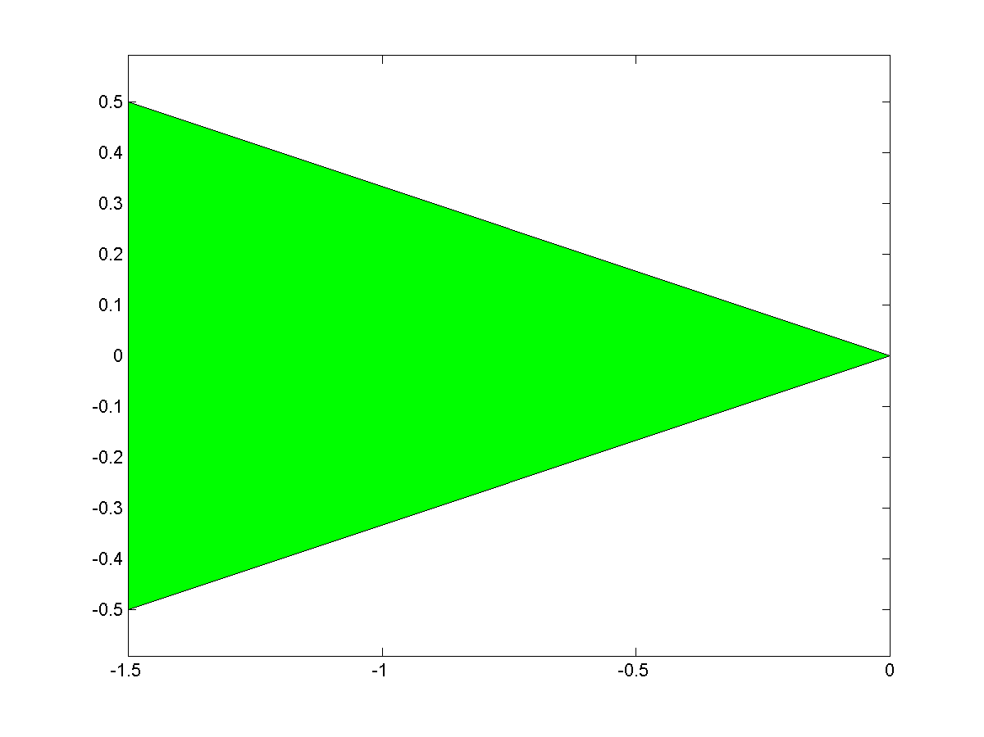
P24

Slide 45
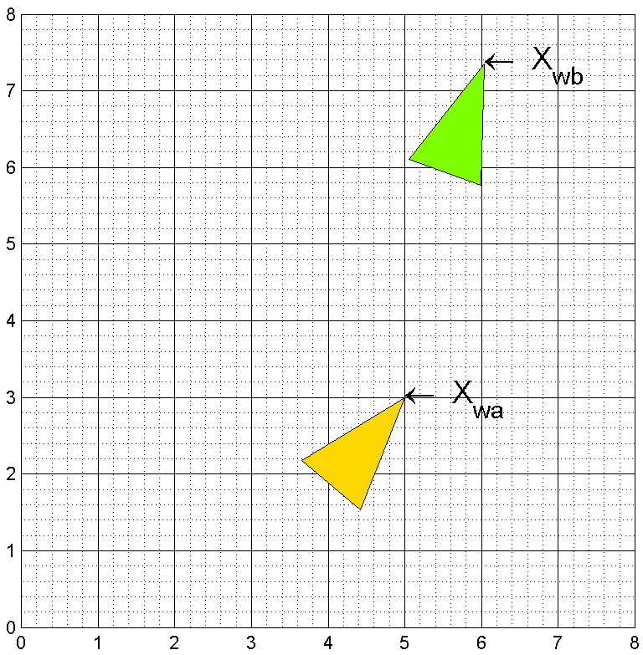
P24

Slide 46
rob = [0 -3 -3;
0 -1 1] * 0.5;
%%
figure('name', 'Robot appearance')
patch(rob(1, :), rob(2, :), 'g');
axis equal;
box on;
print('-dpng', 'robotbody.png');
%%
Xwa = [5; 3; degtorad(50)];
Xab = [4; 2; degtorad(20)];
Xwb = compound(Xwa, Xab);
%%
robA = compound(Xwa, rob);
robB = compound(Xwb, rob);
P24

Slide 47
figure('name', 'Visualization of robot body')
hold on;
axis equal;
grid minor;
xlim([0, 8]);
ylim([0, 8]);
pRobA = patch(robA(1, :), robA(2, :), [255,215,0]/255);
text(Xwa(1), Xwa(2), '\leftarrow X_{wa}', 'FontSize', 18);
pRobB = patch(robB(1, :), robB(2, :), [127,255,0]/255);
text(Xwb(1), Xwb(2), '\leftarrow X_{wb}', 'FontSize', 18);
P24
RGB Color Table
http://www.wahart.com.hk/rgb.htm
http://gucky.uni-muenster.de/cgi-bin/rgbtab-en

Slide 48
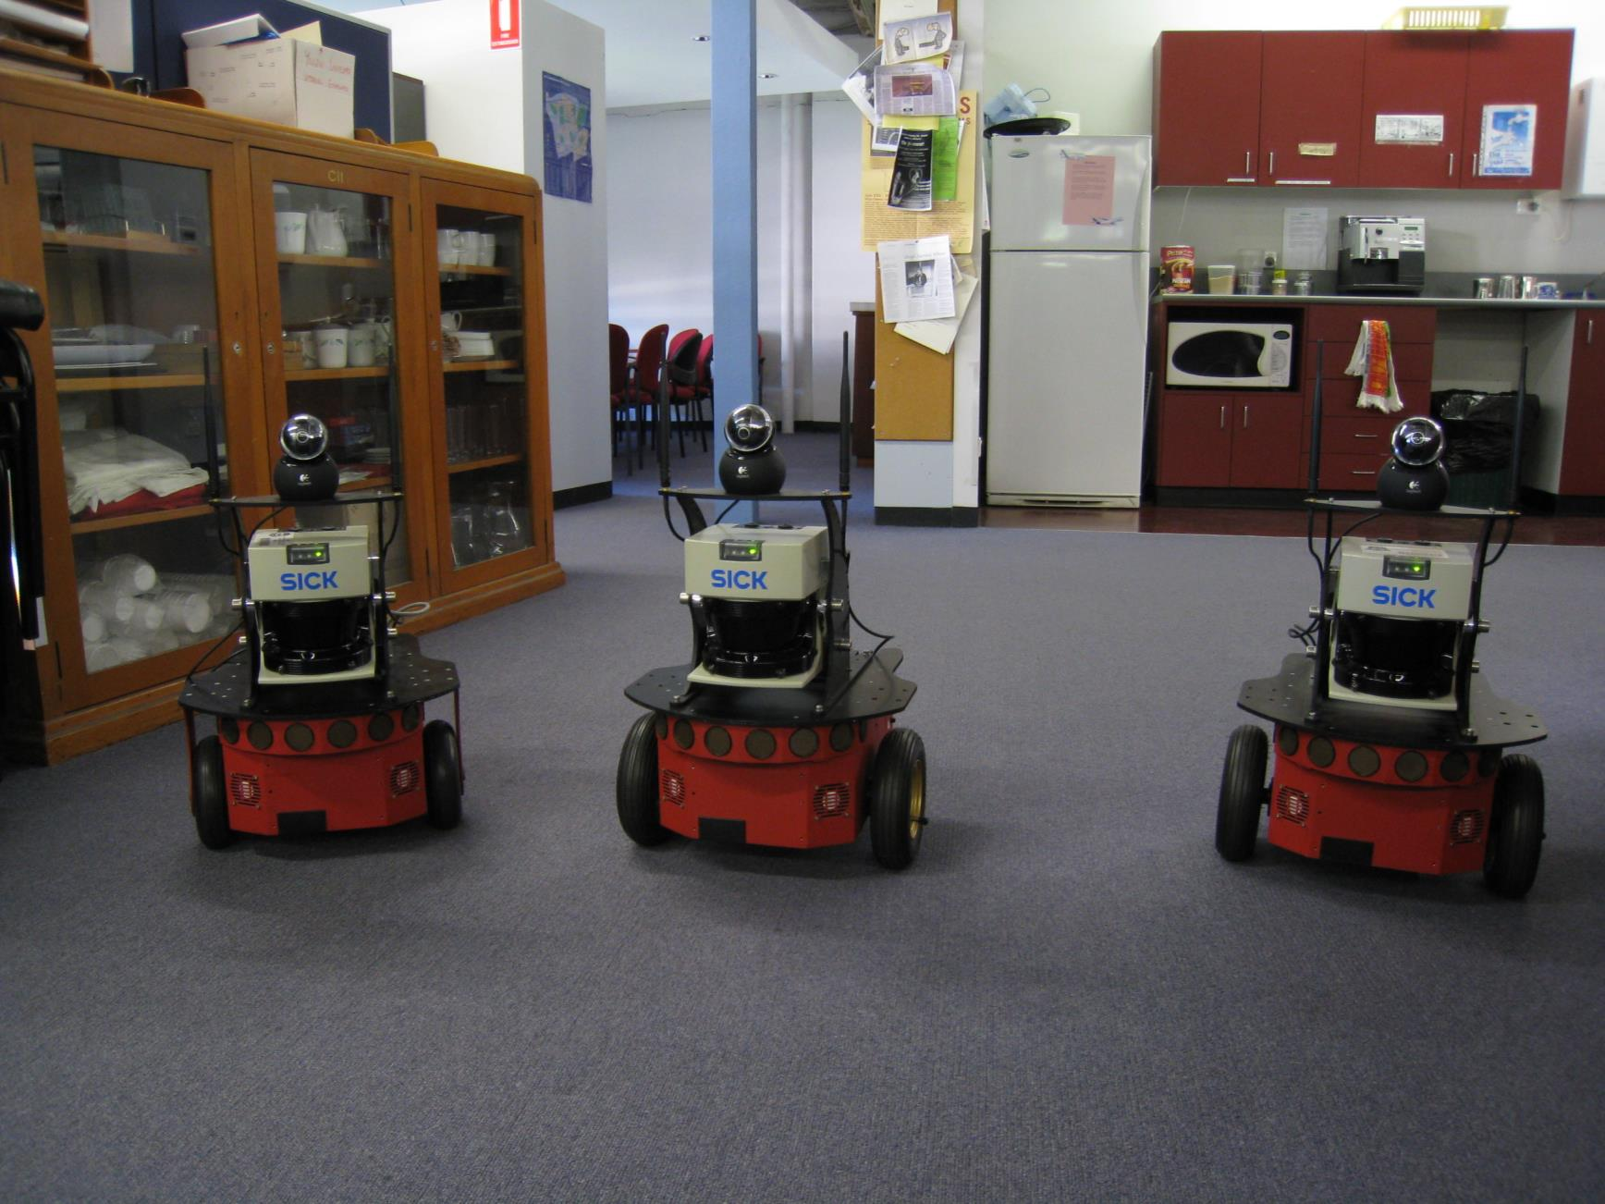
Play with real data

Slide 49
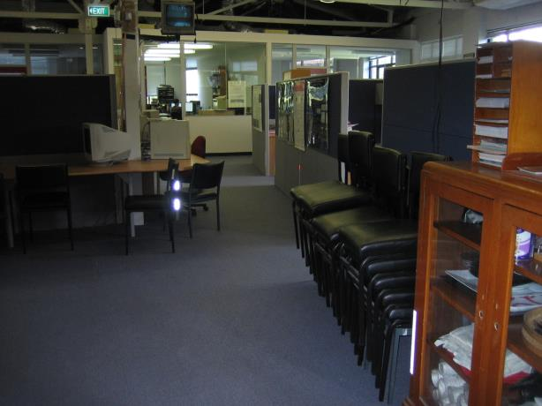
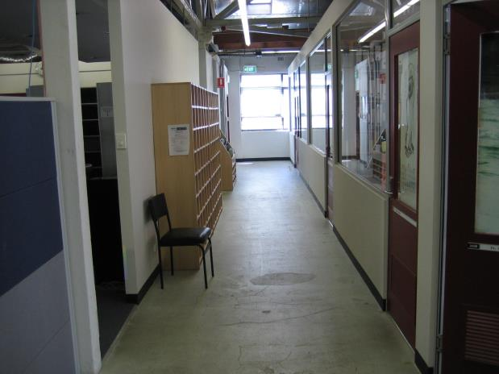
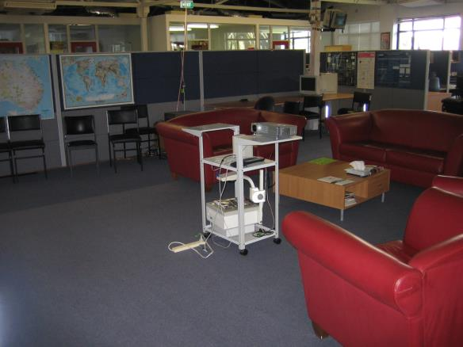
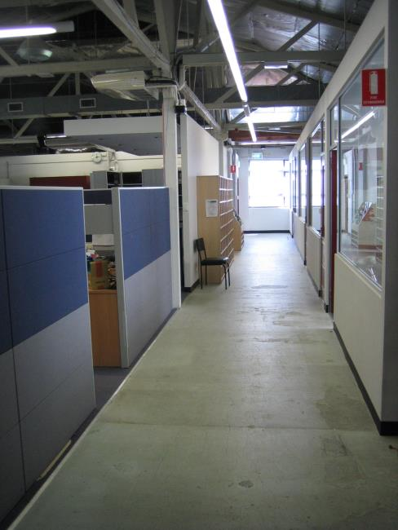
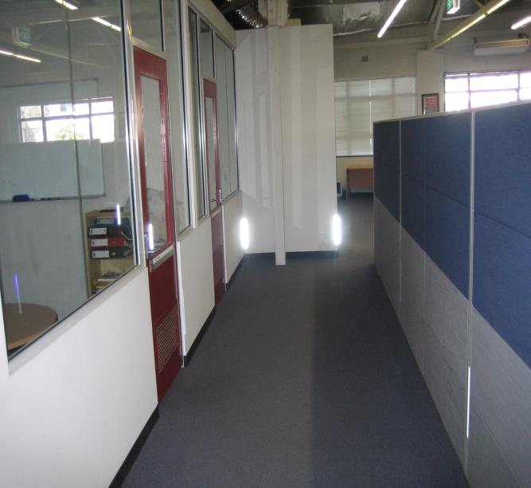


Slide 50
rose.mat
laser
2610 * 361
Laser point clouds
relMotion
3 * 2609
Relative motion
Translation and rotation

Slide 51
Calculate the robot poses with rotation and translations
Let’s implement this!

Slide 52
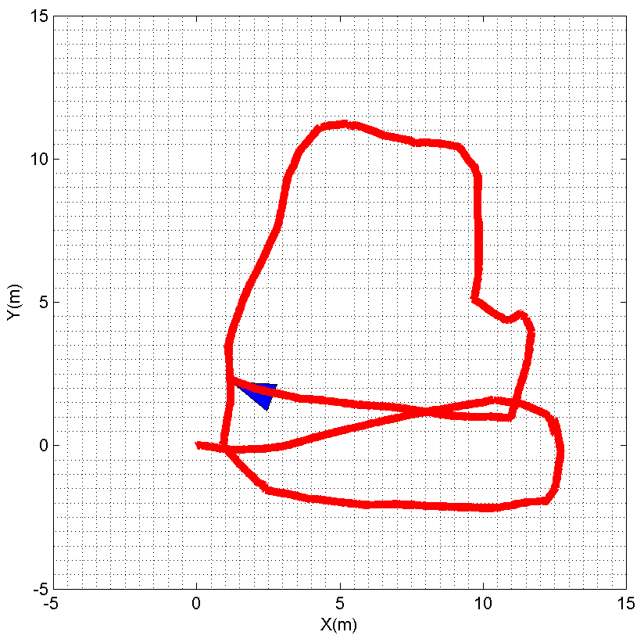
P25

Slide 53
P25
load '../data/rose.mat'
clear laser;
len = size(relMotion, 2);
rob = [0 -3 -3; 0 -1 1] * 0.5;
%% Initialize figure
figPos = get(0, 'ScreenSize'); % [left, bottom, width, height]
figPos(3) = figPos(3) - 100;
figure('name', 'Motion animation',...
'position', figPos,...
'color', 'w', 'Menu', 'none');
hold on; box on;
grid minor;
robPlot = patch(0, 0, 'b', 'erasemode', 'normal');
pathPlot = plot (0, 0, 'r-', 'linewidth', 5, 'erasemode','background');
xlabel('X(m)');
ylabel('Y(m)');
axis equal;
axis([-5 15 -5 15]);

Slide 54
P25
pos = zeros(3, 1);
path = zeros(3, len + 1);
for i = 1 : len
pos = compound(pos, relMotion(:, i));
path(:, i+1) = pos;
robPos = compound(pos, rob);
set(robPlot, 'xdata', robPos(1, :), 'ydata', robPos(2, :));
set(pathPlot, 'xdata', path(1, 1:i), 'ydata', path(2, 1:i));
drawnow;
pause(0.005);
end

Slide 55
Make video with Matlab
NOTE: The p26 employs the object VideoWriter and is debugged on Matlab 2013a, it might be not compatible with the version before 2011b.
P26
Let’s implement this!

Slide 56
%% Initialize vedio maker
videoObj = VideoWriter('robot.avi');
videoObj.FrameRate = 5;
videoObj.Quality = 100;
open(videoObj);
if mod(i, 6) == 0
frame = getframe;
writeVideo(videoObj, frame);
End
close(videoObj);
P26

Slide 57
Cartesian VS. Polar
http://en.wikipedia.org/wiki/Cartesian_coordinate_system
http://en.wikipedia.org/wiki/Polar_coordinate_system

Slide 58
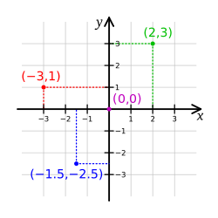


Cartesian coordinate system
a coordinate system that specifies each point uniquely in a plane by a pair of numerical coordinates, which are the signed distances from the point to two fixed perpendicular directed lines, measured in the same unit of length.
Each reference line is called a coordinate axis or just axis of the system.
the point where they meet is its origin, usually at ordered pair (0, 0).

Slide 59



Polar coordinate system
In which each point on a plane is determined by a distance from a fixed point and an angle from a fixed direction.
The fixed point (analogous to the origin of a Cartesian system) is called the pole, and the ray from the pole in the fixed direction is the polar axis. The distance from the pole is called the radial coordinate or radius, and the angle is the angular coordinate, polar angle, or azimuth.

Slide 60

The coordinate of pose a is (5m, 3m, 50degree) ; The pose b’s displacement and rotation are 7m and 40degree w.r.t pose a’s robot-centered frame.
What is the coords. of b w.r.t world frame?

Slide 61
The coordinate of pose a is (5m, 3m, 50degree) ; The pose b’s displacement and rotation are 7m and 40degree w.r.t pose a’s robot-centered frame.
Range
Bearing
What is the coords. of b w.r.t world frame?

Slide 62
Transform Polar to Cartesian
Compound Xwa and Xab
Let’s implement this!

Slide 63
path(path, genpath('../p22'));
Xwa = [5; 3; degtorad(50)];
disB = 7;
rotB = degtorad(40);
[xab, yab] = pol2cart(rotB, disB);
Xab = [xab; yab; rotB];
Xwb = compound(Xwa, Xab);
fprintf('Xwb is (%.2fm, %.2fm, %.2fdegree)\n',...
Xwb(1), Xwb(2), radtodeg(Xwb(3)));
P27

Slide 64


Dead reckoning
head-to-tail
Compounding
http://en.wikipedia.org/wiki/Dead_reckoning
Displacement
Displacement
Displacement
Rotation
Rotation
Rotation

Slide 65
Odometry
head-to-tail
Compounding
Displacement
Displacement
Displacement
Rotation
Rotation
Rotation

Slide 66

Odometry
head-to-tail
Compounding
Encoder

Slide 67


Slide 68


Slide 69
Visual Odometry

Slide 70



Slide 71

A
B

Slide 72




+
=

Slide 73




1. Pixels selection
2. Stereovision
4. Motion
estimation
3. Pixels tracking
Stereovision

Slide 74

仅基于视觉……

Slide 75


Slide 76


Slide 77



Laser point clouds transformation

Slide 78


Slide 80


Slide 82
Transform Polar to Cartesian
Compound Xwa and Xaf

Slide 83
rose.mat
laser
2610 * 361
Laser point clouds
relMotion
3 * 2609
Relative motion
Translation and rotation

Slide 84

load '../data/rose.mat'
Let’s visualize the data!

Slide 85


P28

Slide 86
for i = 1 : len
points = getLaserPoint(laser(i, :), maxR);
set(lsrFig, 'xdata', points(1,:), ...
'ydata', points(2, :));
title(sprintf('Laser image Frame %d', i));
drawnow;
if mod(i, 4) == 0 && vedio
frame = getframe;
writeVideo(videoObj, frame);
end
if vedio == 0
pause(0.02);
end
end
P28

Slide 87
Combine the mapping and localization
P29

Slide 88
for i = 1 : len
pos = compound(pos, relMotion(:, i));
path(:, i+1) = pos;
robPos = compound(pos, rob);
points = getLaserPoint(laser(i+1, :), maxR);
pointsWorld = compound(pos, points);
set(robPlot, 'xdata', robPos(1, :), 'ydata', robPos(2, :));
set(pathPlot, 'xdata', path(1, 1:i), 'ydata', path(2, 1:i));
set(lsrPlot, 'xdata', pointsWorld(1, :), ...
'ydata', pointsWorld(2, :));
plot(pointsWorld(1, 1: n : end), pointsWorld(2, 1: n : end),...
'.', 'markersize', 3, 'color', [169,169,169] / 255);
drawnow;
if mod(i, 6) == 0 && vedio
frame = getframe;
writeVideo(videoObj, frame);
end
end
P29

Slide 89
Inversion

Slide 90
The coordinate of pose b is (5m, 3m, 50degree) w.r.t pose a’s robot-centered frame.
What is the coords. of a w.r.t the robot-centered frame of b?

Slide 91



Slide 92
Transformation matrix
Translation
Rotation
http://en.wikipedia.org/wiki/Transformation_matrix

Slide 93





Slide 94

Compounding
Inversion
Section 3.2.2
[Smith 1990]
Let’s prove it by programming!

Slide 95
syms t x y t;
X = [x; y; t];
negX = -X;
R = [ cos(negX(3)), -sin(negX(3)), 0;
sin(negX(3)), cos(negX(3)), 0;
0, 0, 1];
invR = [ -cos(X(3)), -sin(X(3)), 0;
sin(X(3)), -cos(X(3)), 0;
0, 0, -1];
r1 = R * negX;
r2 = invR * X;
r3 = r1 - r2;
%%
disp('R * (-X) is:');
disp(r1);
disp('inv(R) * X is:');
disp(r2);
P30

Slide 96

Inversion
Section 3.2.2
[Smith 1990]
Let’s prove it by programming!

Slide 97
Xab = [96; 35; degtorad(62)];
Xba = inverse(Xab);
Xab_ = inverse(Xba);
Xab_(3) = radtodeg(Xab_(3));
disp(Xab_);
function Xba = inverse(Xab)
if size(Xab, 1) ~= 3 || size(Xab, 2) ~= 1
error('Xab should be of the size 3*1');
end
R = [ -cos(Xab(3)), -sin(Xab(3)), 0;
sin(Xab(3)), -cos(Xab(3)), 0;
0, 0, -1];
Xba = R * Xab;
Xba(3) = piTopi(Xba(3));
end
P31

Slide 98
Let’s implement this!

Slide 99
path(path, genpath('../p31'));
Xab = [5; 3; degtorad(50)];
Xba = inverse(Xab);
disp('Xba = ')
disp(Xba);
P32

Slide 100
Composite relationships

Slide 101
The coordinate of pose b is (5m, 3m, 50degree) w.r.t pose a’s robot-centered frame. The world coordinate of pose b is (9m, 6m, 70degree).
What is the coords. of a w.r.t the world frame?

Slide 102



Slide 103


Is this the unique solution?

Slide 104



Let’s prove it by programming!

Slide 105
path(path, genpath('../p31'));
path(path, genpath('../p22'));
%%
Xab = [5; 3; degtorad(50)];
Xwb = [9; 6; degtorad(70)];
%% First solution
Xba = inverse(Xab);
Xwa = compound(Xwb, Xba);
disp('Fisrt solution: ')
disp(Xwa);
%% Second solution
Xwa2 = inverse(compound(Xab, inverse(Xwb)));
disp('Second solution: ')
disp(Xwa2);
P33

Slide 106
Bicycle motion model
Courtesy of 许亚芳

Slide 107
Path dynamics
The vehicle performs a continuous movement. To analyze its movement, the derivations are required.
Translation
Rotation
angular derivation (angular velocity)
displacement derivation
(velocity)

Slide 108







Reference point
Front wheel
Wheel-base
Rear wheel
simplification

Slide 109

4-wheel
equivalent
2-wheel

Slide 110



Path dynamics

Slide 111


Path dynamics
How to compute Angular Velocity?

Slide 112


Circular motion
r

Slide 113


Angular velocity

Slide 114



discrete-time vehicle motion

Slide 115

Motion Model

Slide 116




velocity
steering

Slide 117

velocity
steering

Slide 118

Generate path
Based on the way points

Slide 119





Now we consider the waypoint without direction!

Slide 120
This angle must be kept within a certain range to keep balance !
If the vehicle wants to go to the next point, it must turn 50 degree to get there. Obviously, it has exceed its max degree (we assume the max degree is 20 degree)
How to deal with this situation ?

Slide 121



5
2
2
2
2
1

Slide 122
Turn steering
Y
N
Steering < maxG ?
Turn maxG
Go on

Slide 123
Summary
Compute steering
Rate control
Angular control
Let’s learn how to implement it !

Slide 124

P34

Slide 125
P34
Close all;clear all;clc;
Path(path, genpath(‘..\..\robotcourse));
load '../data/tim.mat'
clear lm;
steering=0;velocity=4.0;wheelbase=8;dt=0.05;iWp=1;iPos=1;
rob = [0 -wheelbase -wheelbase; 0 -4 4] ;
%% Initialize figure
figPos = get(0, 'ScreenSize');
figPos(3) = figPos(3) - 100;
figure('name', 'Motion animation',...
'position', figPos,...
'color', 'w', 'Menu', 'none');
hold on; box on;
grid minor;
robPlot = patch(0, 0, 'b', 'erasemode', 'normal');
pathPlot = plot (0, 0, 'r-', 'linewidth', 5, 'erasemode','background');
xlabel('X(m)');
ylabel('Y(m)');
axis equal;
axis([-110 100 -110 100]);

Slide 126
P34
pos = zeros(3, 1);
path = zeros(3, 3390);
%% Main loop
while iWp ~= 0
[steering,iWp]= compSteer(pos, wp, iWp, steering,dt);
pos(1) = pos(1) + velocity *dt *cos(steering +pos(3,:));
pos(2) = pos(2) + velocity *dt *cos(steering +pos(3,:));
pos(3) = pos(3) + velocity *dt *sin(steering)/wheelbase;
pos(3) = piTopi(pos(3));
robPos = compound(pos,rob);
path(:, iPos + 1)= pos;
iPos = iPos + 1;
%%
set(pathPlot,'xdata', path(1, 1:iPos),'ydata',
path(2,1:iPos));
set(robPlot,'xdata',robPos(1,:),'ydata',robPos(2,:));
drawnow;
end
Print(‘-dpng’,’path.png’)

Slide 127
P34
function [G,iwp]= compSteer(x,wp,iwp,G,dt)
maxG= 30*pi/180; rateG= 20*pi/180; minD = 0.5;
cwp= wp(:,iwp);
d2 = (cwp(1)-x(1))^2 + (cwp(2)-x(2))^2;
if d2 < minD^2
iwp = iwp+1; % switch to next
if iwp > size(wp,2) %reached final waypoint,return
iwp =0;return;
end
cwp= wp(:,iwp); % next waypoint
end
deltaG= piTopi(atan2(cwp(2)-x(2),cwp(1)-x(1))-x(3)-G);
% limit rate
maxDelta = rateG*dt;
if abs(deltaG) > maxDelta
deltaG = sign(deltaG)*maxDelta;
end
% limit angle
G= G+deltaG;
if abs(G) > maxG
G= sign(G)*maxG;
end
compSteer

